Slide 1

LifeofScripts
TEAM 9

Slide 2

Introduction
Current library management system often have complex interfaces, limited integration, poor scalability, making them hard to use and inefficient for growing libraries.
By using AI and ML, the system can quickly sort books, recommend titles to readers, answer questions, and make the work faster and smarter for everyone.

Slide 3

IDEA TO IMPLEMENT
Build a digital library management system with AI capabilities:
Book Recommendation System using collaborative filtering or content-based filtering
Overdue Prediction Model using historical borrowing patterns
Chatbot Integration for book search and FAQs using NLP
Smart dashboard for librarians to view trends in book demand and user engagement.

Slide 4
Expected output
Enhanced user experience
Smart borrowing management
Saves time and effort
Data-driven insights
AI-driven book recommendations and chatbot support make book discovery and query resolution faster and more personalized.
The system predicts which books might be returned late, helping users and librarians avoid overdue issues.
Automates routine tasks like issuing, returning, and searching for books, making library work easier.
Usage analytics enable smarter decisions regarding book inventory, user preferences, and library planning.

Slide 5
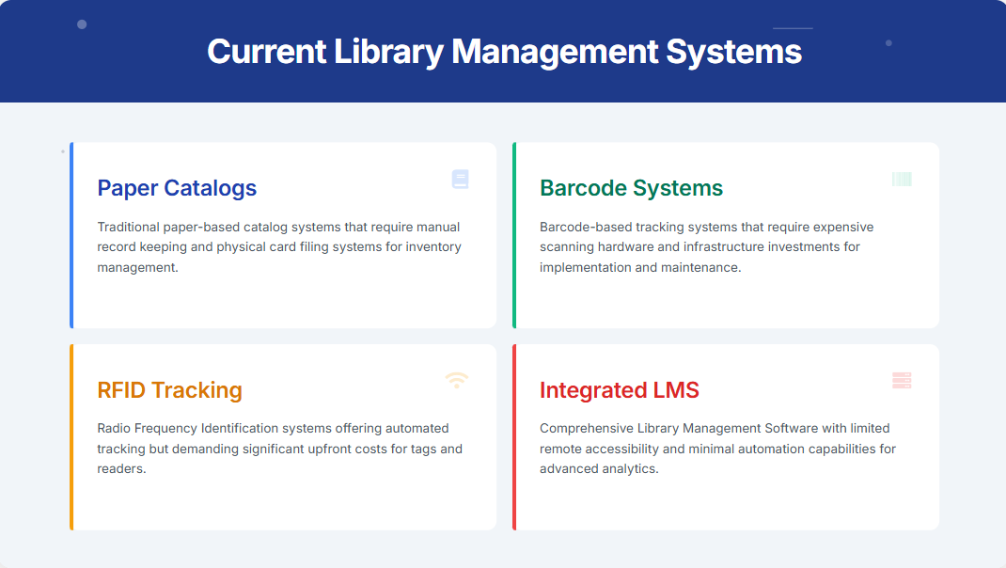








The Full team
Takuma Hayashi​
Mirjam Nilsson​​
Flora Berggren​​
Rajesh Santoshi​​
President​
Chief Executive Officer​
Chief Operations Officer​
VP Marketing​
Graham Barnes​
Rowan Murphy​
Elizabeth Moore​
Robin Kline​
VP Product​
SEO Strategist​
Product Designer​
Content Developer​

Slide 6

FUTURE SCOPE
Future Work:
-Implement Voice-based book search assistant.
-Add Image-based book recognition using deep learning.
-Train deeper ML models for accurate predictions and recommendations.
-Expand to multi-library or university-level systems.

Slide 7

Thank you
Harshitha Readdy - 2410030001
G Jahnavi – 2410030059
Rishika.T – 2410030122
Surabhi Sarda - 2410030123

